Slide 1

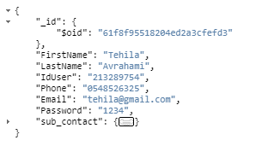

Contact form
User
Image

